Slide 1
Class Schedule Redesign Research Results April 4, 2014 MaryJean H Williams

Slide 2
Task Force Mission
“This Task Force is proposed to analyze and assess the Class Schedule document in terms of its alignment with our college mission, its support for our accreditation requirements, and its effective service of the communication needs it is intended to fulfill.”
Notes:
CCC has an important mission, to serve the district with quality, adaptable, accessible education programs.
We wanted to know if the Class Schedule we mail to everyone in the district was supporting this mission and providing people with the information they need to make the most of education opportunities.

Slide 3
Thank You Class Schedule Redesign Task Force!
Shelly Parini
MaryJean Williams
Melissa Padron
BJ Nicoletti
Tara Sprehe
Cynthia Risen
Lynda Ellingsen
Lenda Black
Steffen Moller
Janet Paulson
Sunny Olsen
Matthew Altman
Kelly Steigleder
Heather Arbuckle
Melissa Pirie
Jennifer Nelson
Notes:
Let’s take a moment to say thank you to the task force members. If you are in the room, please stand up! ☺

Slide 4
Problem Statement
How can we reduce the cost of printing and mailing the Class Schedule, while efficiently and effectively meeting the communication needs of our community?

Slide 5
Outcomes:
Optimize the Class Schedule as a powerful communication and marketing tool.
Reduce printing, production and mailing expenses in a spirit of stewardship.
Learn insights to feed into the rebranding project planned for next year.
Build a legacy of sustainable, effective communication.

Slide 6
Methods
Five Focus Groups, 64 participants
Harmony
Associated Student Government
Advising, Enrolling and Student Services
Wilsonville
Oregon City
General Online Survey
515 respondents

Slide 7
Who did we hear from?
Community members
515 survey responses
64 focus group participants
Many subpopulations with varied interests
Credit-seeking students
264 survey responses
12 ASG student leaders
Notes:
We hear from 276 students and 579 community members through the survey and focus groups.
We learned our different audiences have very different informational needs and it makes sense to design tools to support those needs.

Slide 8
What is your relationship to CCC?
Notes:
On the survey, we heard from 264 students, 237 residents of Clackamas County, and 201 faculty or staff members at CCC.

Slide 9
Diverse Community Audiences
Community education participants
Students
Instructors
Community education partners
Future students
Workforce training and education clients
Small Business stakeholders
Educationally vulnerable populations

Slide 10
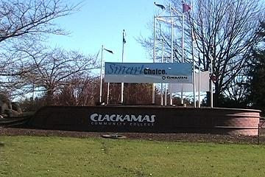
Diverse Information Needs
Marketing & outreach- colorful!
Community education class schedule
Organized by learning interests
Workforce development
Computer skills classes
Art, fitness, etc.
Si Habla Español
GED, ESL, Basic education
More analysis is needed

Slide 11
“When the Class Schedule comes in the mail, do you typically…”
Notes:
45% set the Class Schedule aside and look at it later. 23% don’t look at it at all, 32% look at it immediately. Virtually none of the students who responded waited until they received a schedule at home to decide and to register.
We have a 77% opportunity for improvement, in catching the attention of our community. What would make them want to look through it immediately for educational opportunities?

Slide 12
Community Information Needs
“What’s in the mailbox needs to catch them, and inspire them to follow up on their learning dreams.”
Notes:
What does the community need to hear from us?
“What’s in the mailbox needs to catch them, and inspire them to follow up on their learning dreams.”

Slide 13
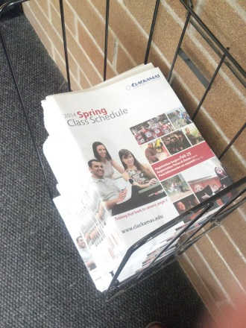
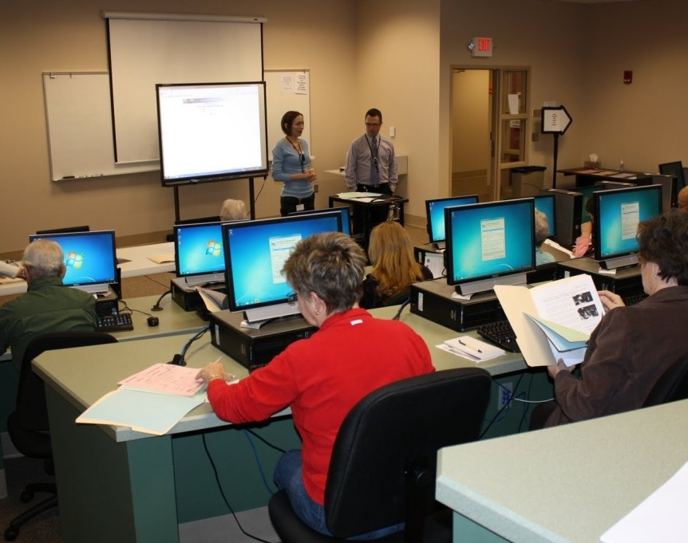
Credit-seeking students are are internet savvy!
Notes:
Students, on the other hand, are internet savvy.

Slide 14
What is your preferred method of registering for classes?
Notes:
We asked them how they prefer to register for classes.
Overwhelmingly, they do this on the website.
Students use the catalog to plan their schedule, then go online to register.
Easy paper to online interface is essential.
So knowing this, what do they need from their Class Schedule?

Slide 15
Where do you turn for information on enrollment and registration?
Notes:
Overwhelmingly, 75% of students use the website.
21% print the schedule of classes, or portions of it from the website.
34% of them refer to the Printed Class Schedule for planning, then go online to check class availability and register.

Slide 16
Do you pick up the Class Schedule at any of the following locations?
Notes:
Of the 34% of students who use a printed schedule, overwhelmingly they pick it up on campus.
They don’t use it if it is mailed to their homes, and currently, it comes too late. Most have already registered.
59% rate receiving it at home as neutral to very unimportant

Slide 17
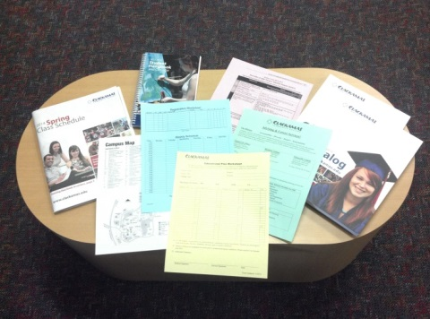
Credit-seeking Students
Findings
Recommendations
Don’t use mailed schedule
Need course offerings up to a year in advance
34% use the Class Schedule as a planning tool
Seek information online
Register online
Need information in a step-by-step order
Distribute it on campus only
Provide an annual class schedule
Organize according to stages of degree completion
Provide easy links to details
Provide easy links to online registration
Design a how-to degree planning guide.
Notes:
93% of focus group participants said a how to/planning guide was needed.
A top 10 comment was that more lead time for class offerings was needed, from two weeks earlier to one year in advance.
If a year round projection of classes were made available to them, they could use it to plan out their entire degree program with more clarity and confidence.
It could also be printed only once per year.
This picture depicts the varied collection of resources students and advisors currently use to plan a degree. What would a comprehensive planning tool look like?

Slide 18
Credit-seeking students stages of degree completion
1 Getting started
2 Plan a degree program
3 Check class availability online
4 Register online
5 Pay
6 Graduation, transfer, career
Notes:
The first stage, Apply means getting started, applying for financial aid, essential dates including the final exam schedule, campus map, student services, how to transfer to CCC, and specialized guidance for different “new” student groups such as Vets, CLOP, Retraining, Learning Center, Advanced college credit, etc.
2. The second stage, Planning, requires course offerings and descriptions for the whole year, plus degree grids that currently have to be copied from the catalog.
3. Checking class availability. Students and Advisors know that the printed schedule doesn’t reflect space available. Seamless interface between the printed planning guide and going online to check available courses is essential. Students need myClackamas orientation now to access information about what classes have room in them, and where they are located.
4. Registration. This includes times & dates of registration, priority registration and step by step guide on how to go online to register.
5. Pay. How to pay, how to manage financial aid awards.
6. Graduation. This includes guidance on transfscript analysis, staying on track, updating student information.

Slide 19
Two Different Publications Needed
for COMMUNITY for STUDENTS
in the Mailbox on Campus
Notes:
Students and community members have very different information needs and one publication doesn’t meet those needs in an efficient way.
Stakeholder’s information needs would be best met by two different publications, one mailed to the community for marketing, outreach, workforce development and community education programs,
and another one for degree seeking students, to be picked up on campus.

Slide 20
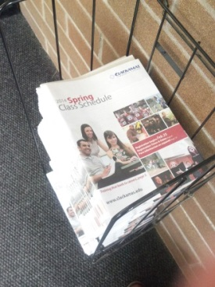
Summary of Recommendations
Degree seeking Students
Community and Community Ed
Colorful marketing focus
Learning interest tool
Community Education class schedule
Printed four times per year
Organized by learning topics
Mailed to everyone
Easy interface to website
Technical focus
Degree planning tool
Annual credit-seeking class schedule
Annual publication
Organized by stages of degree completion
Picked up on campus
Easy interface to website
Notes:
Here is a summary of the two suggested publications. You can see how different they are by putting their information needs side by side.
Currently, the schedule is mailed four times per year.
If the student version represents an annual schedule, it only needs to be printed once per year.
Will this idea save any paper? It depends on how the design is refined, but I can make some quick estimates.
And we only need enough copies for on campus use, not for everyone in the district, saving over 13,487,550 pages of paper per year.
As a stack, that’s about two tenths of a mile high. (At 1080 pages per inch)
Here’s the math:
Current printing is 65 pages x 4 times per year = 260 x 121,335 schedules per term = 31,547,100 pages/two sided print = 15,773,550 used on mailing for credit schedule.
Annual Class Schedule would print 127 pages x 1 time per year x 36,000 students = 4,572,000 pages/two sided print = 2,286,000
Any questions?

Slide 21
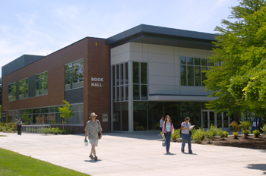
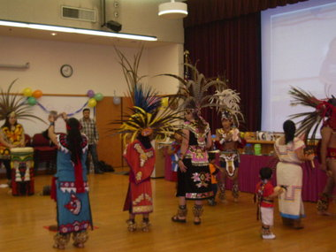
Thank you for supporting Clackamas Community College!

Slide 22
Credits
United States Census- internet access at home by state
http://depts.clackamas.edu/research/StudentDemographic.aspx
Graphics- Jennifer Nelson
Photos-Clackamas Community College website and Google Images
Schedule of Classes Q&A

